Slide 1
2.DE ecosystem

Slide 2
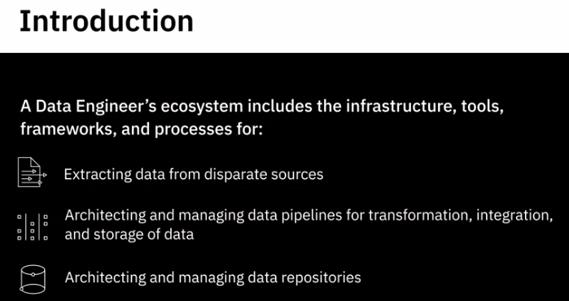
1. Introduction

Slide 3
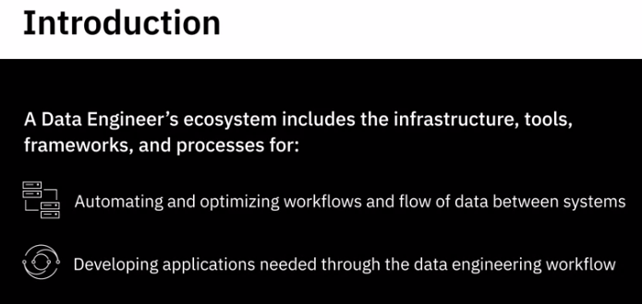
1. Introduction

Slide 4
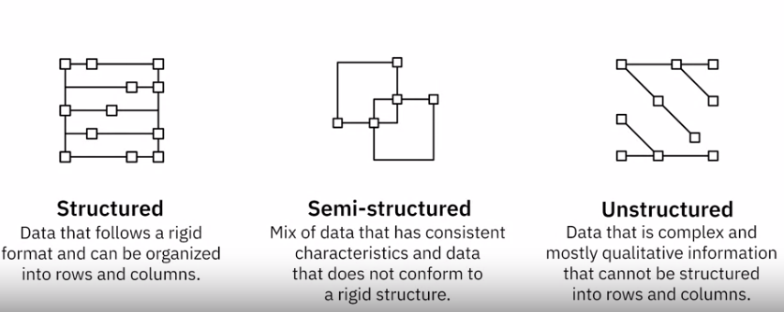
1. Introduction - Data
For example of Semi-structured, emails. An email has a mix of structured data, such as the name of the sender and recipient, but also has the contents of the email, which is unstructured data

Slide 5
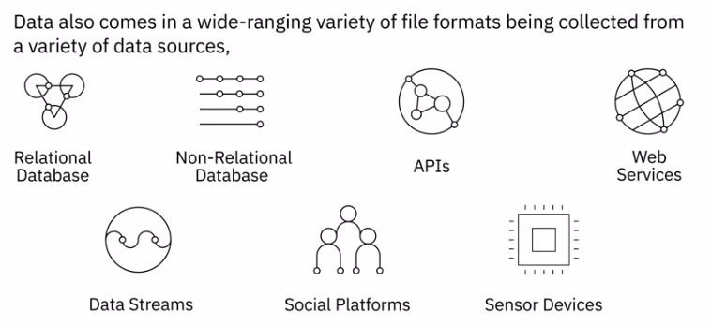
1. Introduction - Data

Slide 6
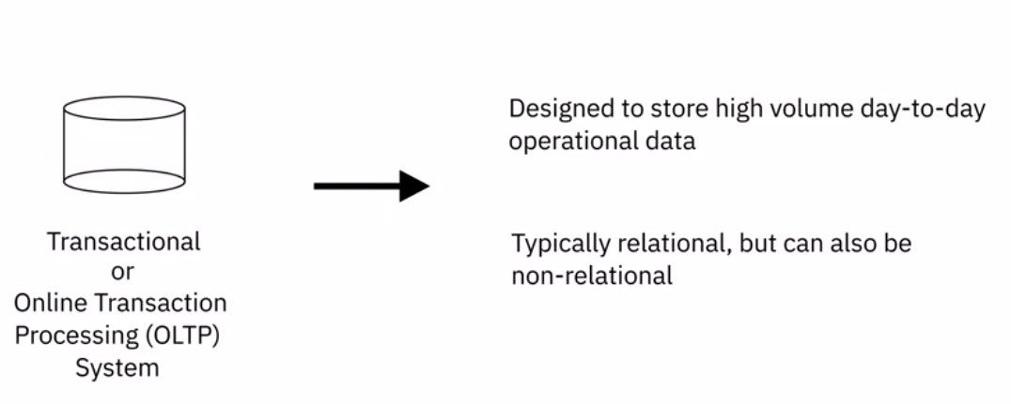
1. Introduction - Data repository
Such as online banking transactions, ATM transactions, and airline bookings

Slide 7
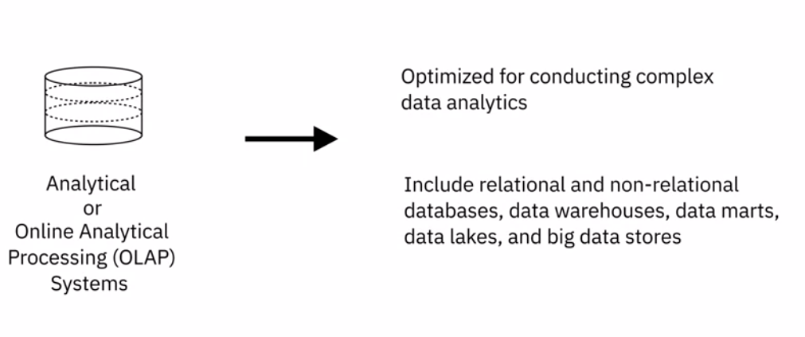
1. Introduction - Data repository

Slide 8
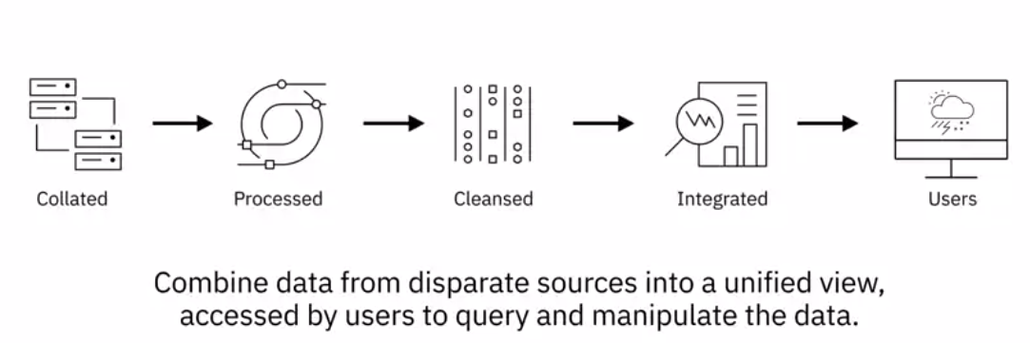
1. Introduction - Data Integration
Once data from disparate sources has been collated, it needs to be processed, cleansed, and integrated so that it can be accessed via a single interface by users

Slide 9
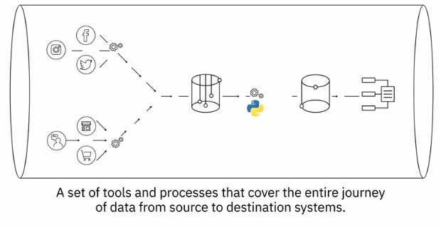
1. Introduction - Data Pipeline

Slide 10
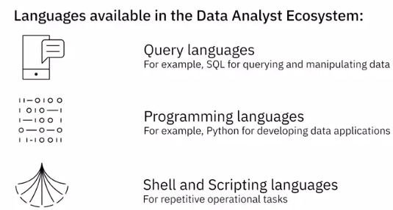
1. Introduction - 3 languages

Slide 11
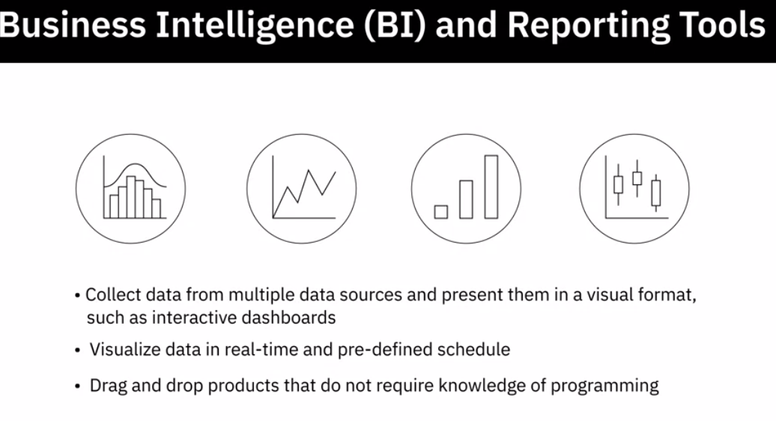
1. Introduction - BI

Slide 12
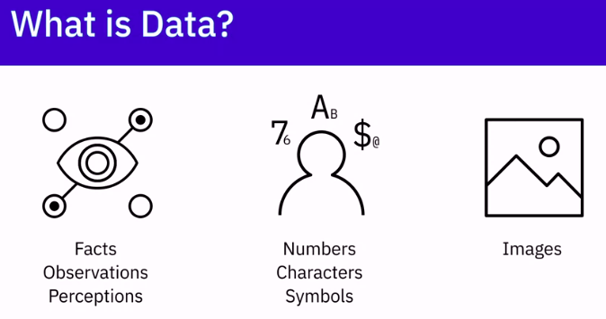
2. Types of data

Slide 13
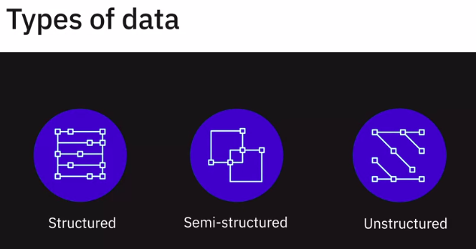
2. Types of data

Slide 14
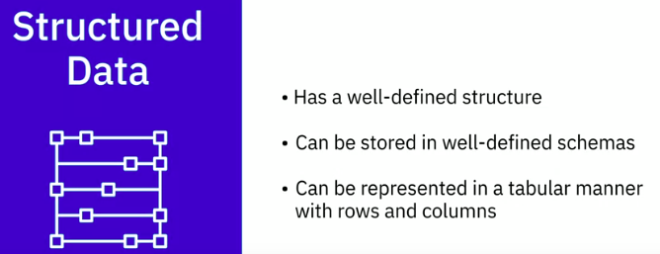
2. Types of data - Structured Data

Slide 15
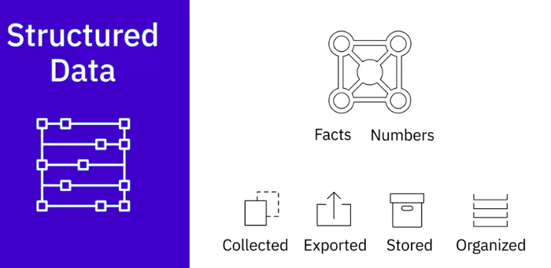
2. Types of data - Structured Data
Structured data is objective facts and numbers that can be collected, exported, stored, and organized in typical databases.

Slide 16
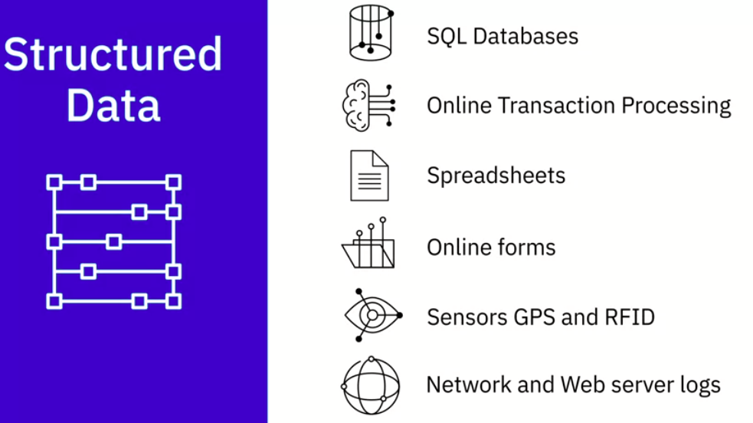
2. Types of data - Structured Data
Databases and Online Transaction Processing (or OLTP) Systems that focus on business transactions Spreadsheets such as Excel and Google Spreadsheets Online forms Sensors such as Global Positioning Systems (or GPS) and Radio Frequency Identification (or RFID) tags

Slide 17
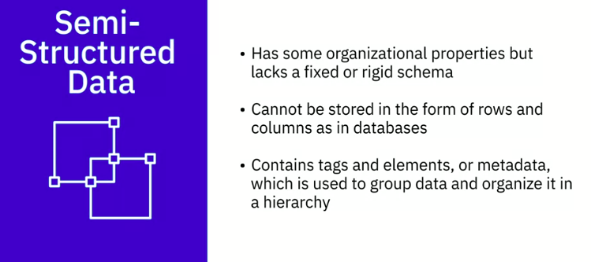
2. Types of data - Semi-Structured Data

Slide 18
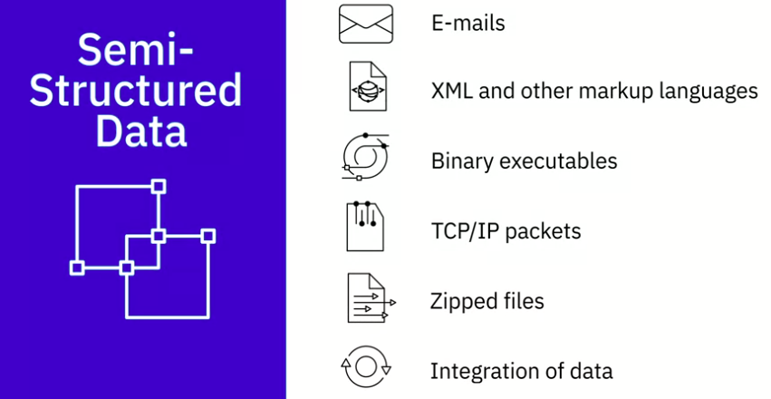
2. Types of data - Semi-Structured Data

Slide 19
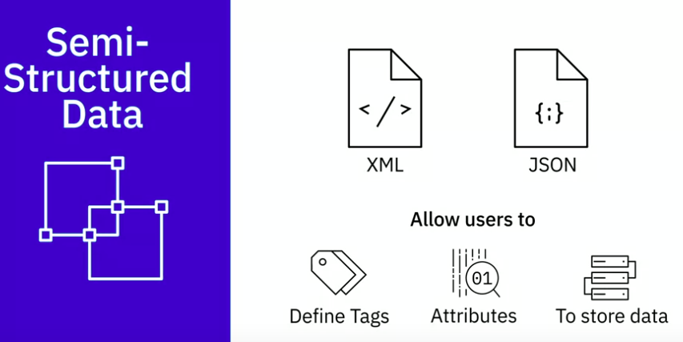
2. Types of data - Semi-Structured Data
different sources XML and JSON allow users to define tags and attributes to store data in a hierarchical form and are used widely to store and exchange semi-structured data

Slide 20
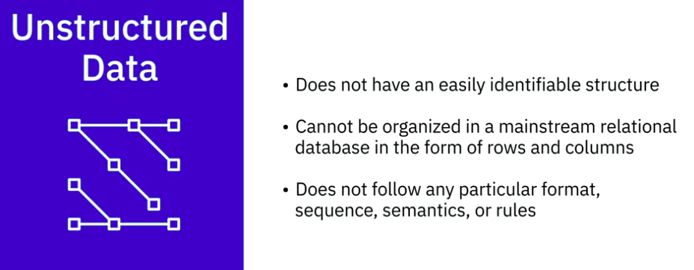
2. Types of data - Unstructured Data
Unstructured data can deal with the heterogeneity of sources and has a variety of business intelligence and analytics applications.

Slide 21
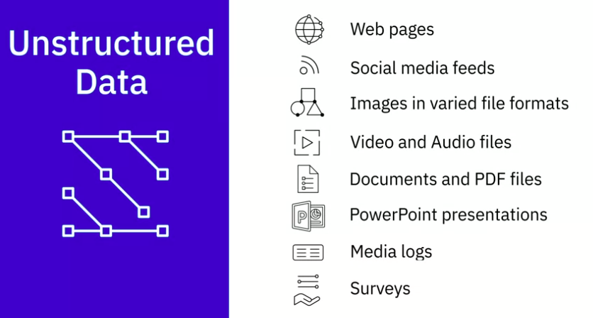
2. Types of data - Unstructured Data

Slide 22
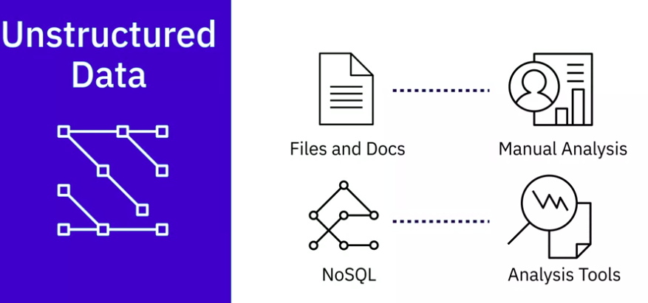
2. Types of data - Unstructured Data

Slide 23
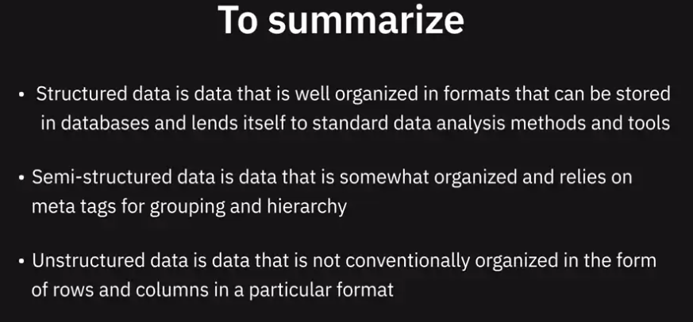
2. Types of data

Slide 24
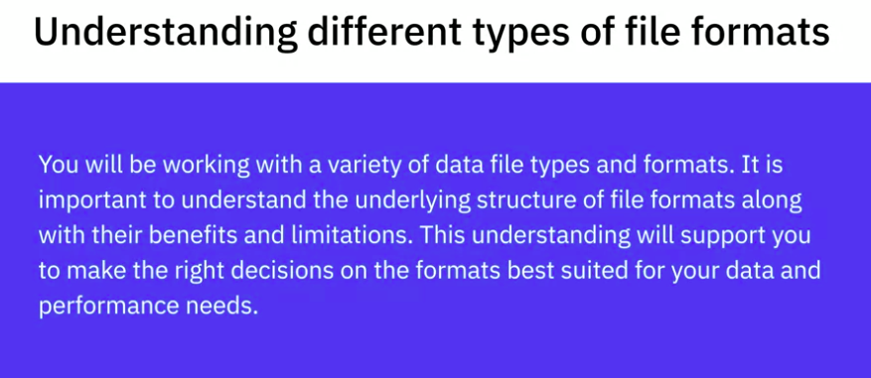
3. Understanding Different Types of File Formats

Slide 25
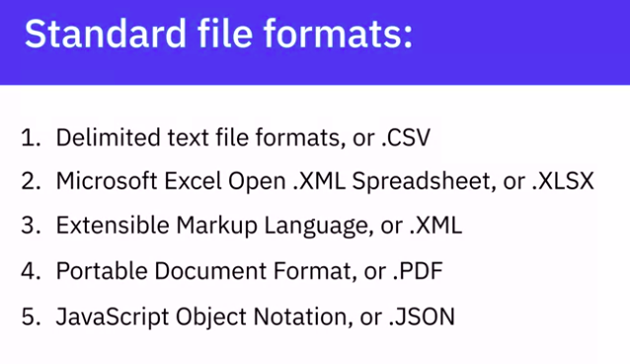
3. Understanding Different Types of File Formats

Slide 26
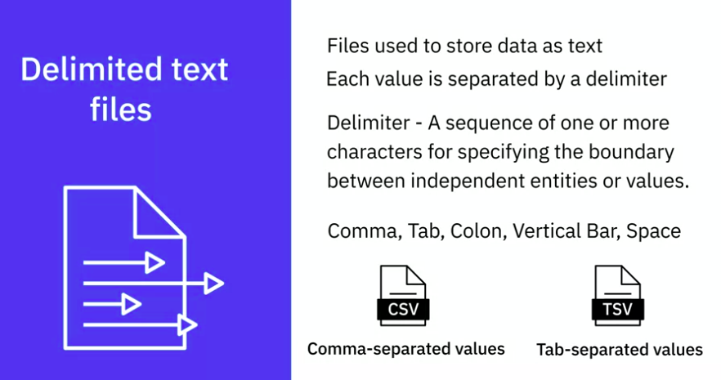
3. Delimited text files
Any character can be used to separate the values, but most common delimiters are the comma, tab, colon, vertical bar, and space

Slide 27
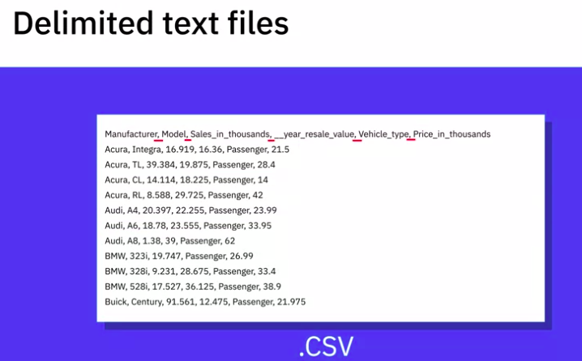
3. Delimited text files
The first row works as a column header, where each column can have a different type of data. For example, a column can be of date type, while another can be a string or integer type data

Slide 28
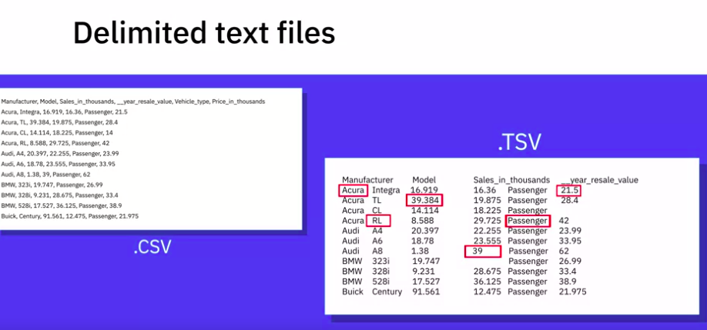
3. Delimited text files

Slide 29
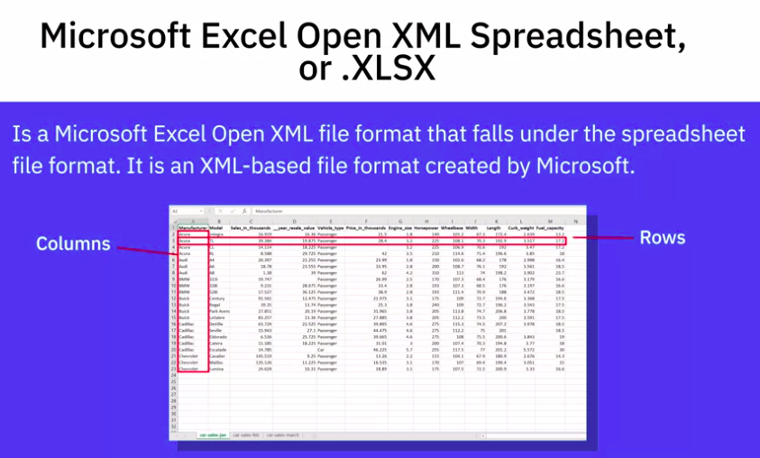
3. XML / XLSX

Slide 30
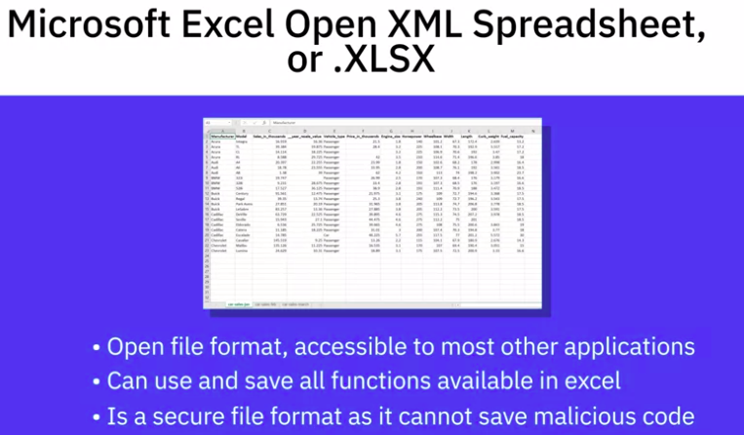
3. XML / .XLSX

Slide 31
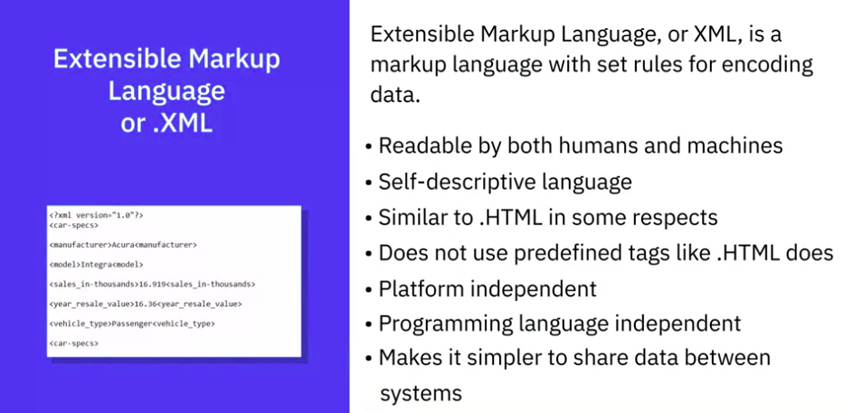
3. .XML

Slide 32
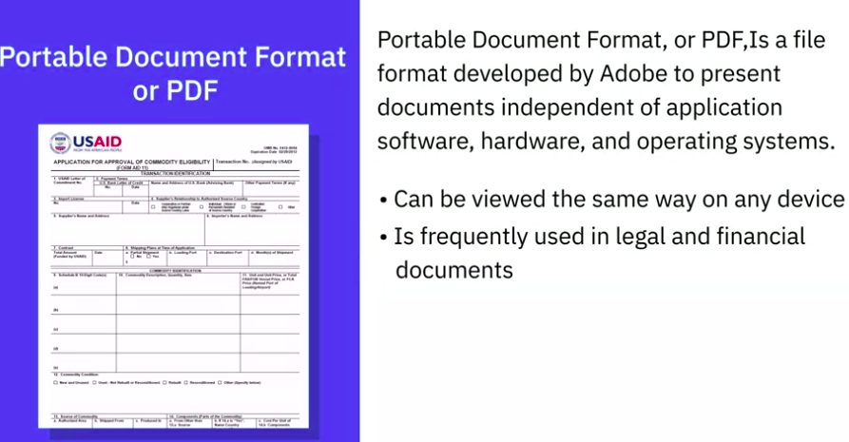
3. PDF

Slide 33
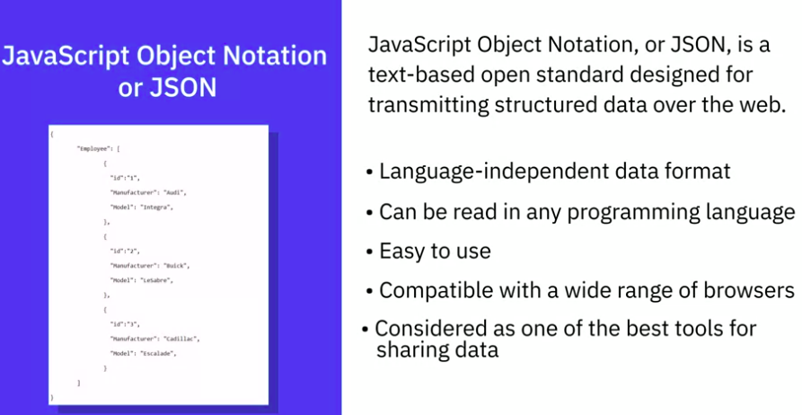
3. JSON
as one of the best tools for sharing data of any size and type, even audio and video. That is one reason, many APIs and Web Services return data as JSON

Slide 34
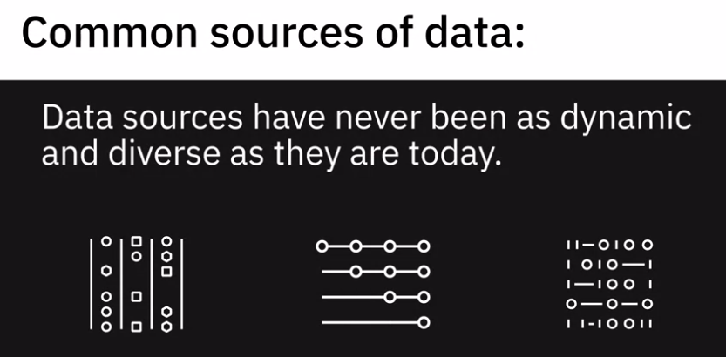
4. Source of Data

Slide 35
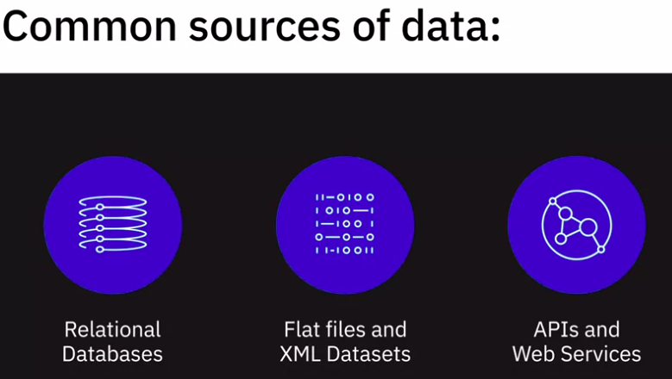
4. Source of Data

Slide 36
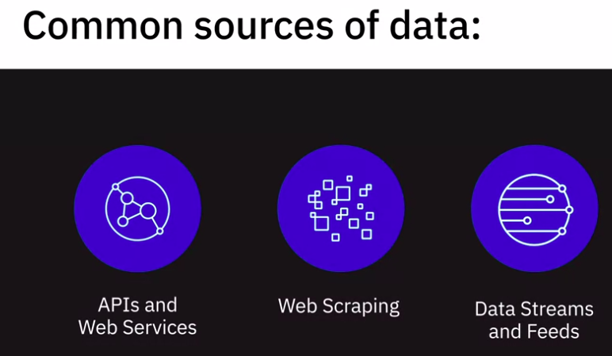
4. Source of Data

Slide 37
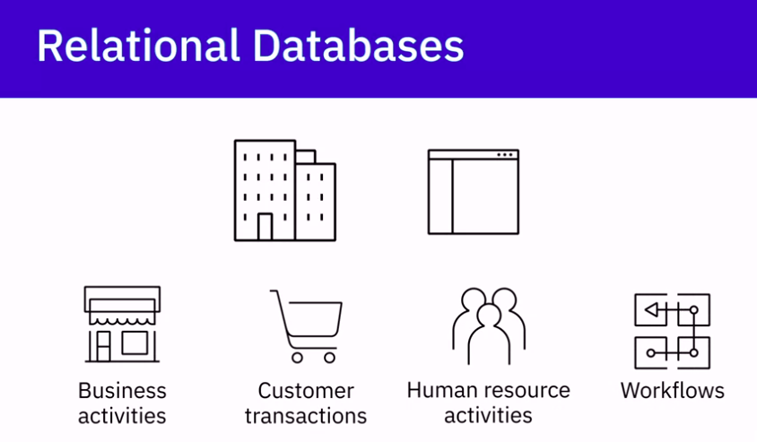
4. Source of Data - Relational Databases
Typically, organizations have internal applications to support them in managing their day to day business activities, customer transactions, human resource activities, and their workflows

Slide 38
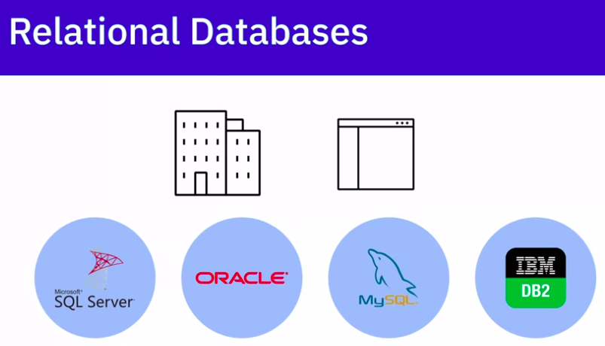
4. Source of Data - Relational Databases
These systems use relational databases such as SQL Server, Oracle, MySQL, and IBM DB2, to store data in a structured way.

Slide 39
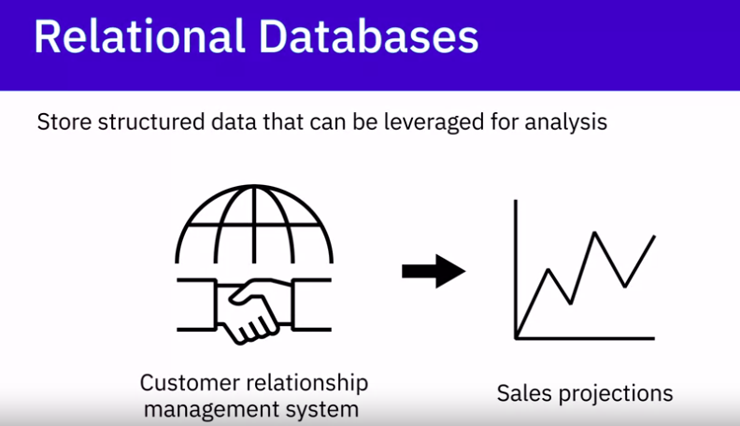
4. Source of Data - Relational Databases
Data stored in databases and data warehouses can be used as a source for analysis. For example, data from a retail transactions system can be used to analyze sales in different regions, and data from a customer relationship management system can be used for making sales projections.

Slide 40
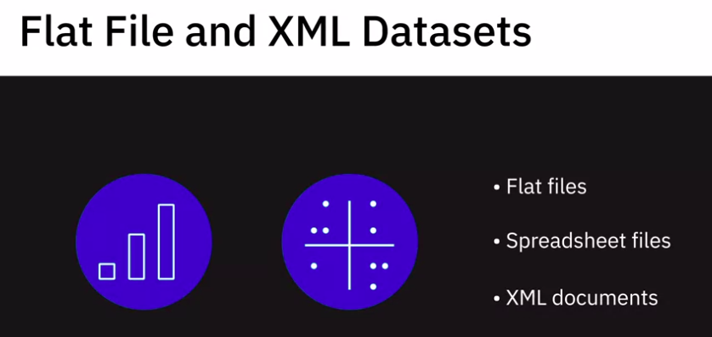
4. Source of Data - Relational Databases
Such data sets are typically made available as flat files, spreadsheet files, or XML documents

Slide 41
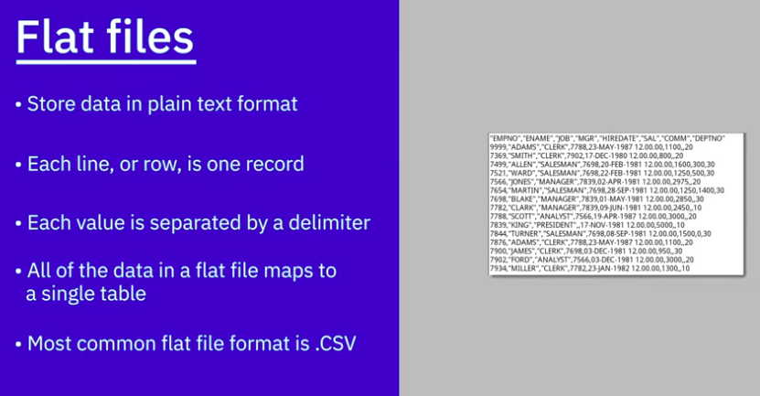
4. Source of Data - Relational Databases - Flat File

Slide 42
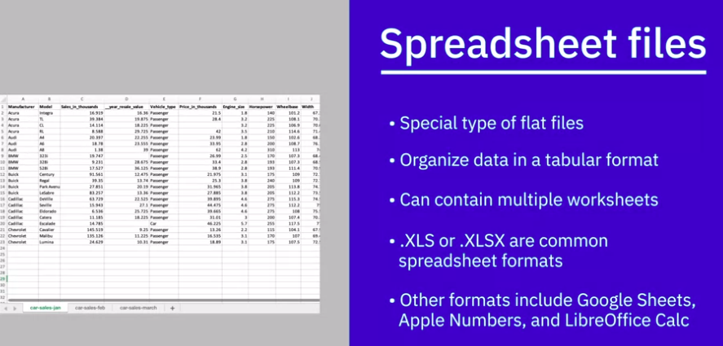
4. Source of Data - Relational Databases - Spreadsheet files
Although data in spreadsheets is in plain text, the files can be stored in custom formats and include additional information such as formatting, formulas, etc.

Slide 43
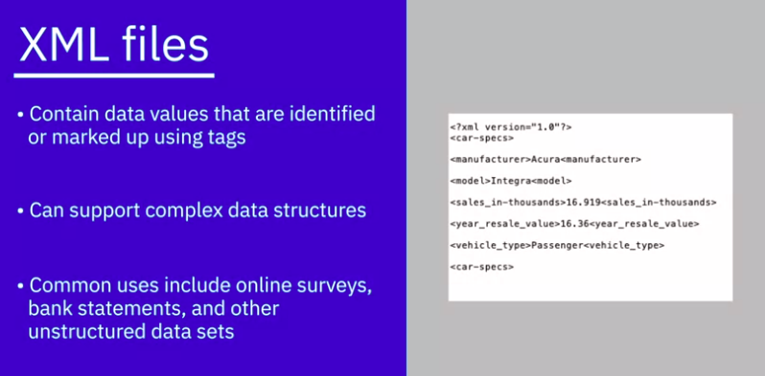
4. Source of Data - Relational Databases - XML

Slide 44
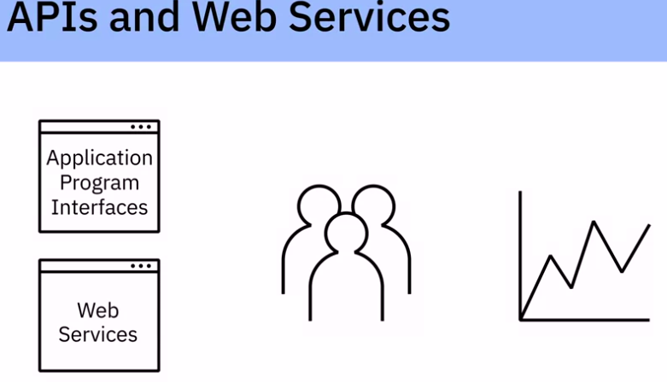
4. Source of Data - APIs and Web Services
Many data providers and websites provide APIs, or Application Program Interfaces, and Web Services, which multiple users or applications can interact with and obtain data for processing or analysis

Slide 45
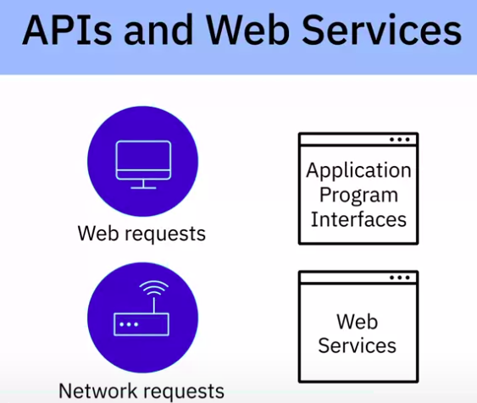
4. Source of Data - APIs and Web Services
XML, HTML, JSON, Plain text, media files
APIs and Web Services typically listen for incoming requests, which can be in the form of web requests from users or network requests from applications, and return data in plain text, XML, HTML, JSON, or media files.

Slide 46
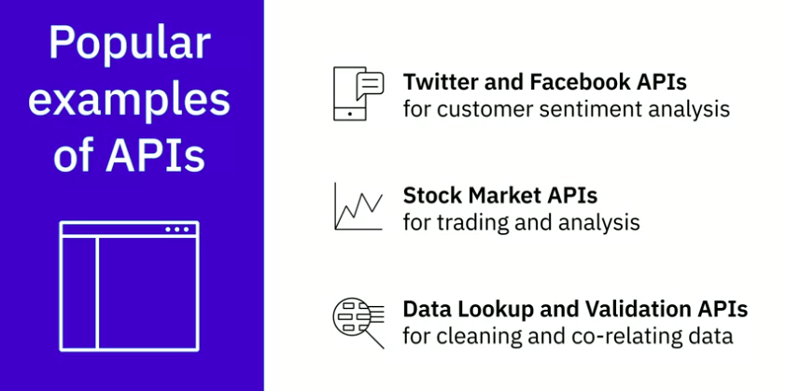
4. Source of Data - APIs and Web Services

Slide 47
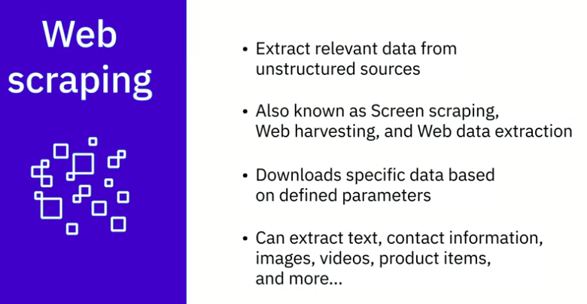
4. Source of Data - Web Scraping

Slide 48
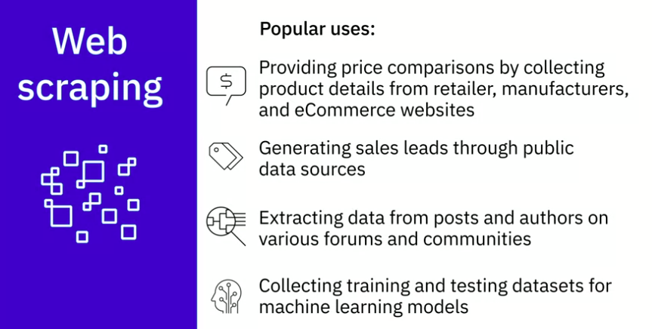
4. Source of Data - Web Scraping

Slide 49
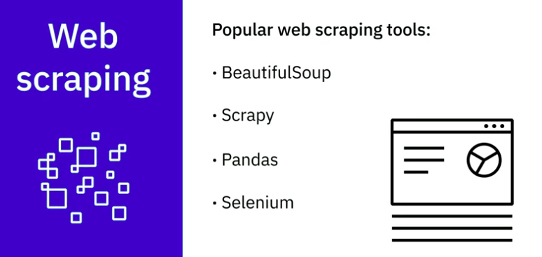
4. Source of Data - Web Scraping

Slide 50
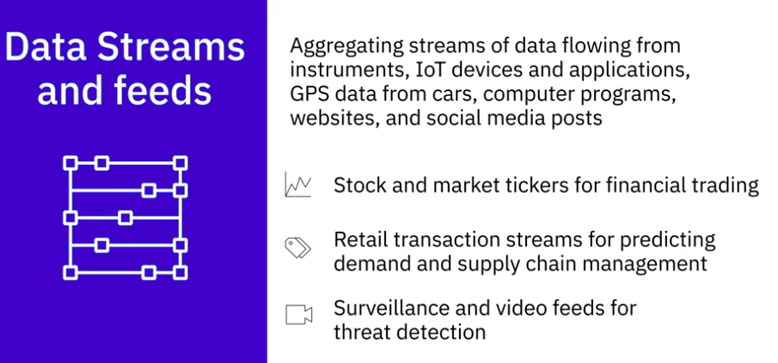
4. Source of Data - Data Streams and feeds

Slide 51
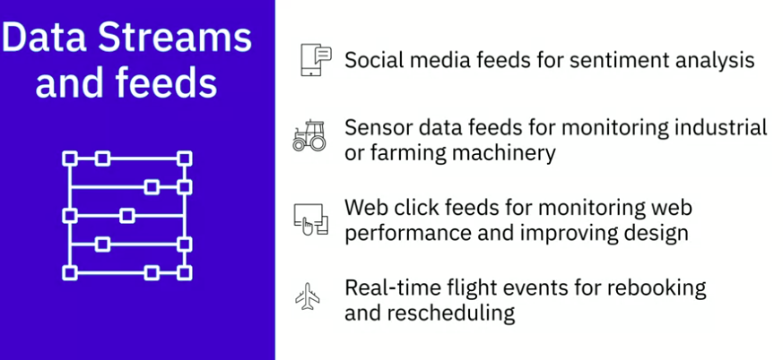
4. Source of Data - Data Streams and feeds

Slide 52

4. Source of Data - Data Streams and feeds

Slide 53

4. Source of Data - Data Streams and feeds

Slide 54

5. Languages for Data Professionals
Having proficiency in at least one language in each category is essential for any data professional

Slide 55

5. Languages for Data Professionals

Slide 56

5. Shell and scripting - Unix / Linux shell
It is a series of UNIX commands written in a plain text file to accomplish a specific task. Writing a shell script is fast and easy. It is most useful for repetitive tasks that may be time-consuming to execute by typing one line at a time

Slide 57

5. Shell and scripting - Unix / Linux shell

Slide 58

5. Shell and scripting - Unix / Linux shell

Slide 59

6. Point of views from professionals of Data

Slide 60

6. Point of views from professionals of Data

Slide 61

6. Point of views from professionals

Slide 62

Quiz

Slide 63

Quiz

Slide 64

Quiz
Quiz

Slide 65

Quiz
Quiz

Slide 66

Quiz
Quiz

Slide 67
Quiz
Quiz

Slide 68

Quiz
Quiz

Slide 69

Quiz
Quiz

Slide 70

Quiz
Quiz

Slide 71

Quiz
Quiz

